Slide 1
Terrestrial ecosystem carbon budgets

Slide 2
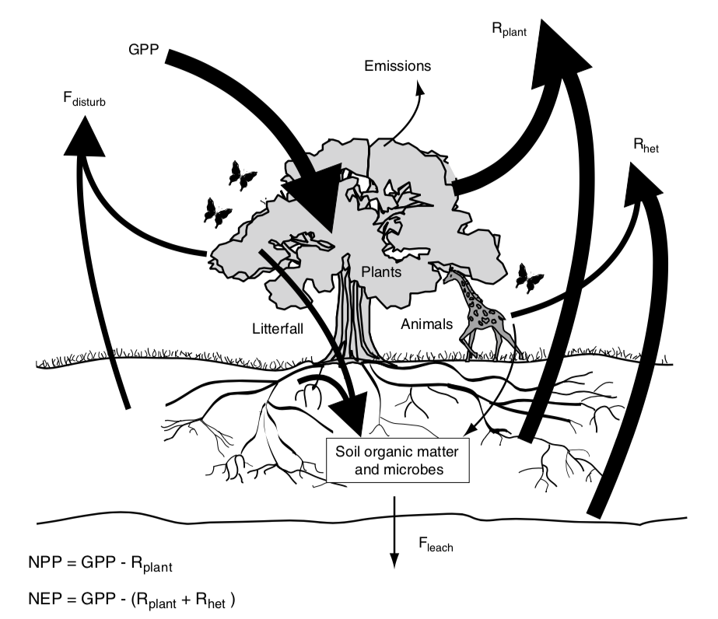
Terrestrial Ecosystem Carbon Cycle

Slide 3
NEP = GPP – (R_{plant} + R_{heterotroph})

Slide 4
NEP = GPP – (R_{plant} + R_{heterotroph})
Net ecosystem production (total flux of C into ecosystem; per ground area)

Slide 5
NEP = GPP – (R_{plant} + R_{heterotroph})
Heterotrophic respiration (C flux out from heterotrophs; per ground area)

Slide 6
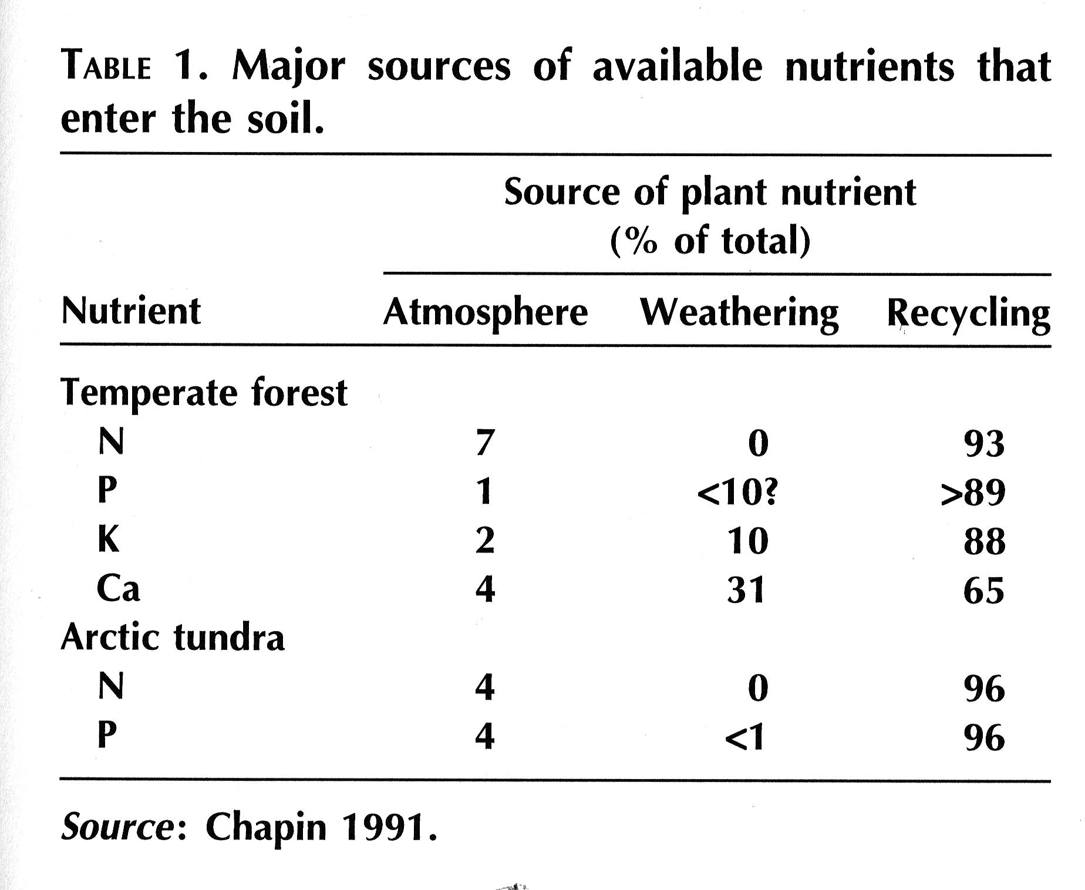
What stands out about this table?

Slide 7
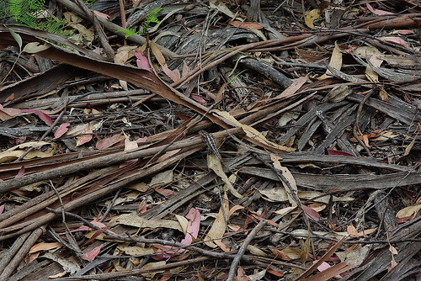
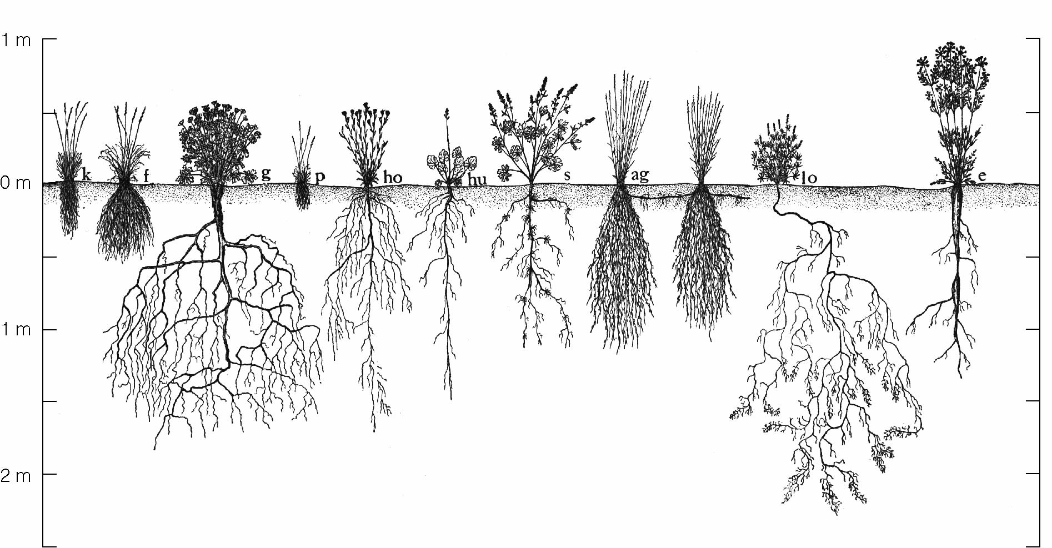
Detritus

Slide 8
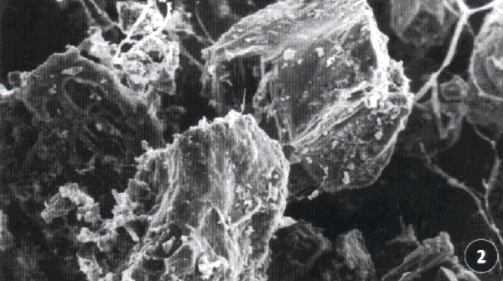
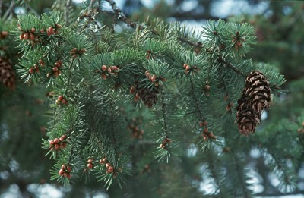
Decomposition of Organic Matter
Decomposition is a process that includes many different biochemical reactions that lead to loss of organic material as CO2 and the release of mineral nutrients and water
Decomposition results from:
Leaching – compounds out of detritus
Fragmentation – breakdown of protective coating
Chemical alteration of OM by bacterial and fungal enzymes

Slide 9
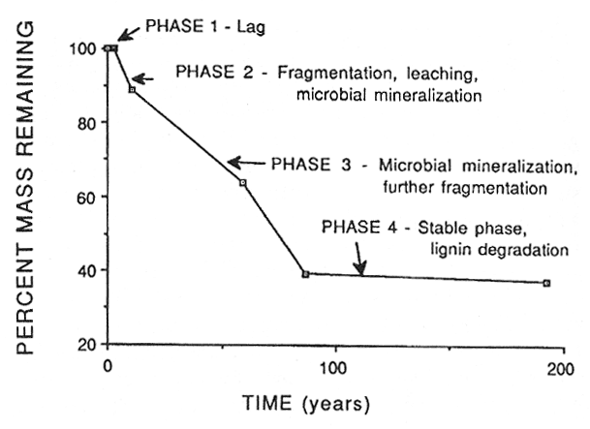

Slide 10
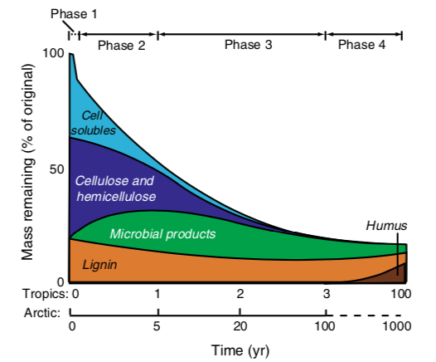
Microbes break down easy stuff before moving to more recalcitrant material

Slide 11
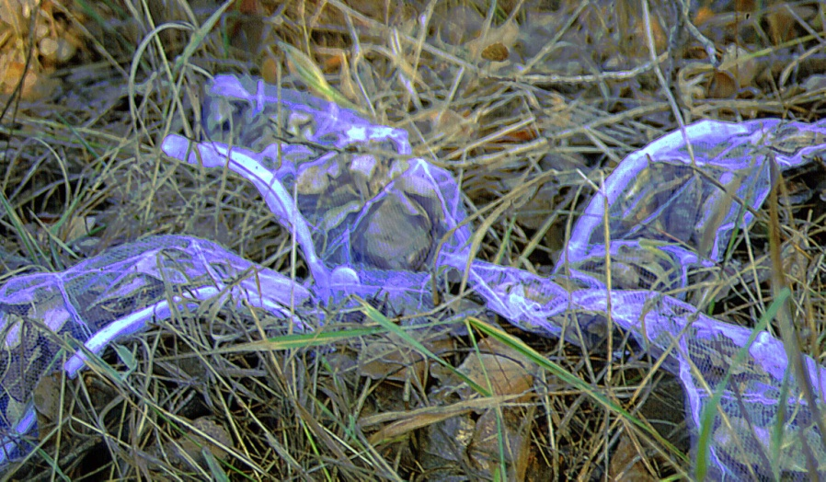
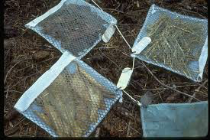
The rate of decomposition

Slide 12
The rate of decomposition
Slope = decomposition rate (K)

Slide 13
Major controls of decomposition
Litter Quality
Climate
Decomposition
Soil Fauna

Slide 14
Major controls of decomposition
Litter Quality
Climate
Decomposition
Soil Fauna

Slide 15
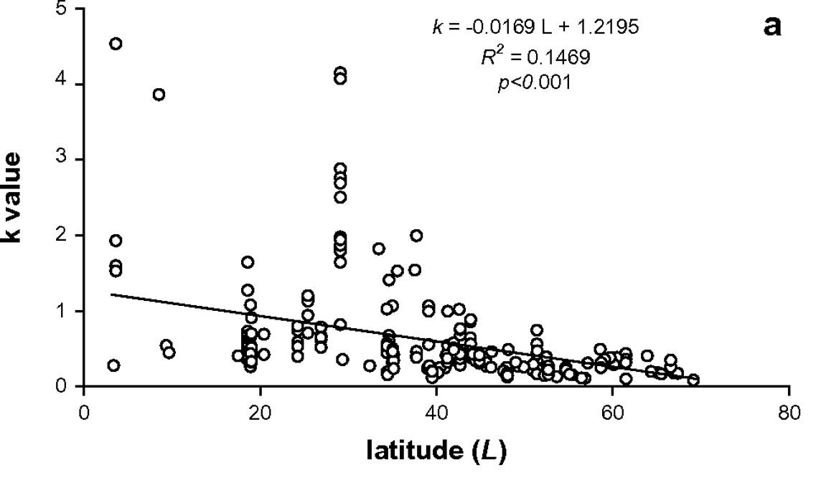
Climate and decomposition
Zhang et al. 2008

Slide 16
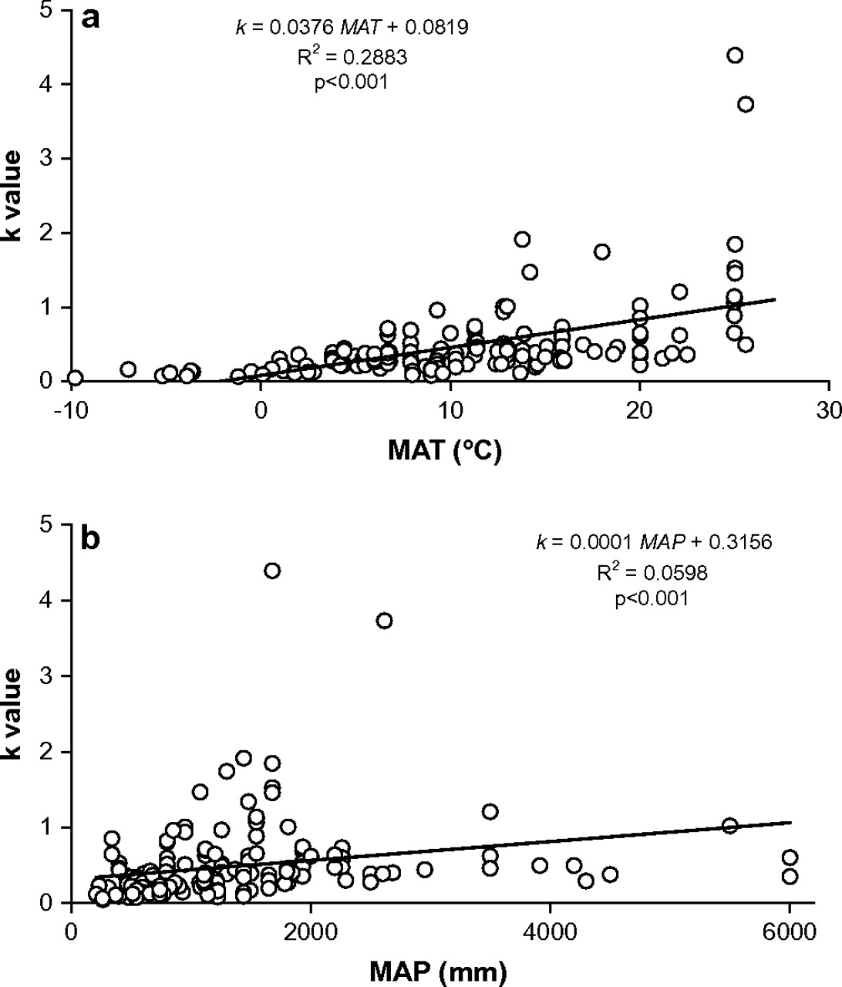
Climate and decomposition
Zhang et al. 2008

Slide 17
Major controls of decomposition
Litter Quality
Climate
Decomposition
Soil Fauna

Slide 18
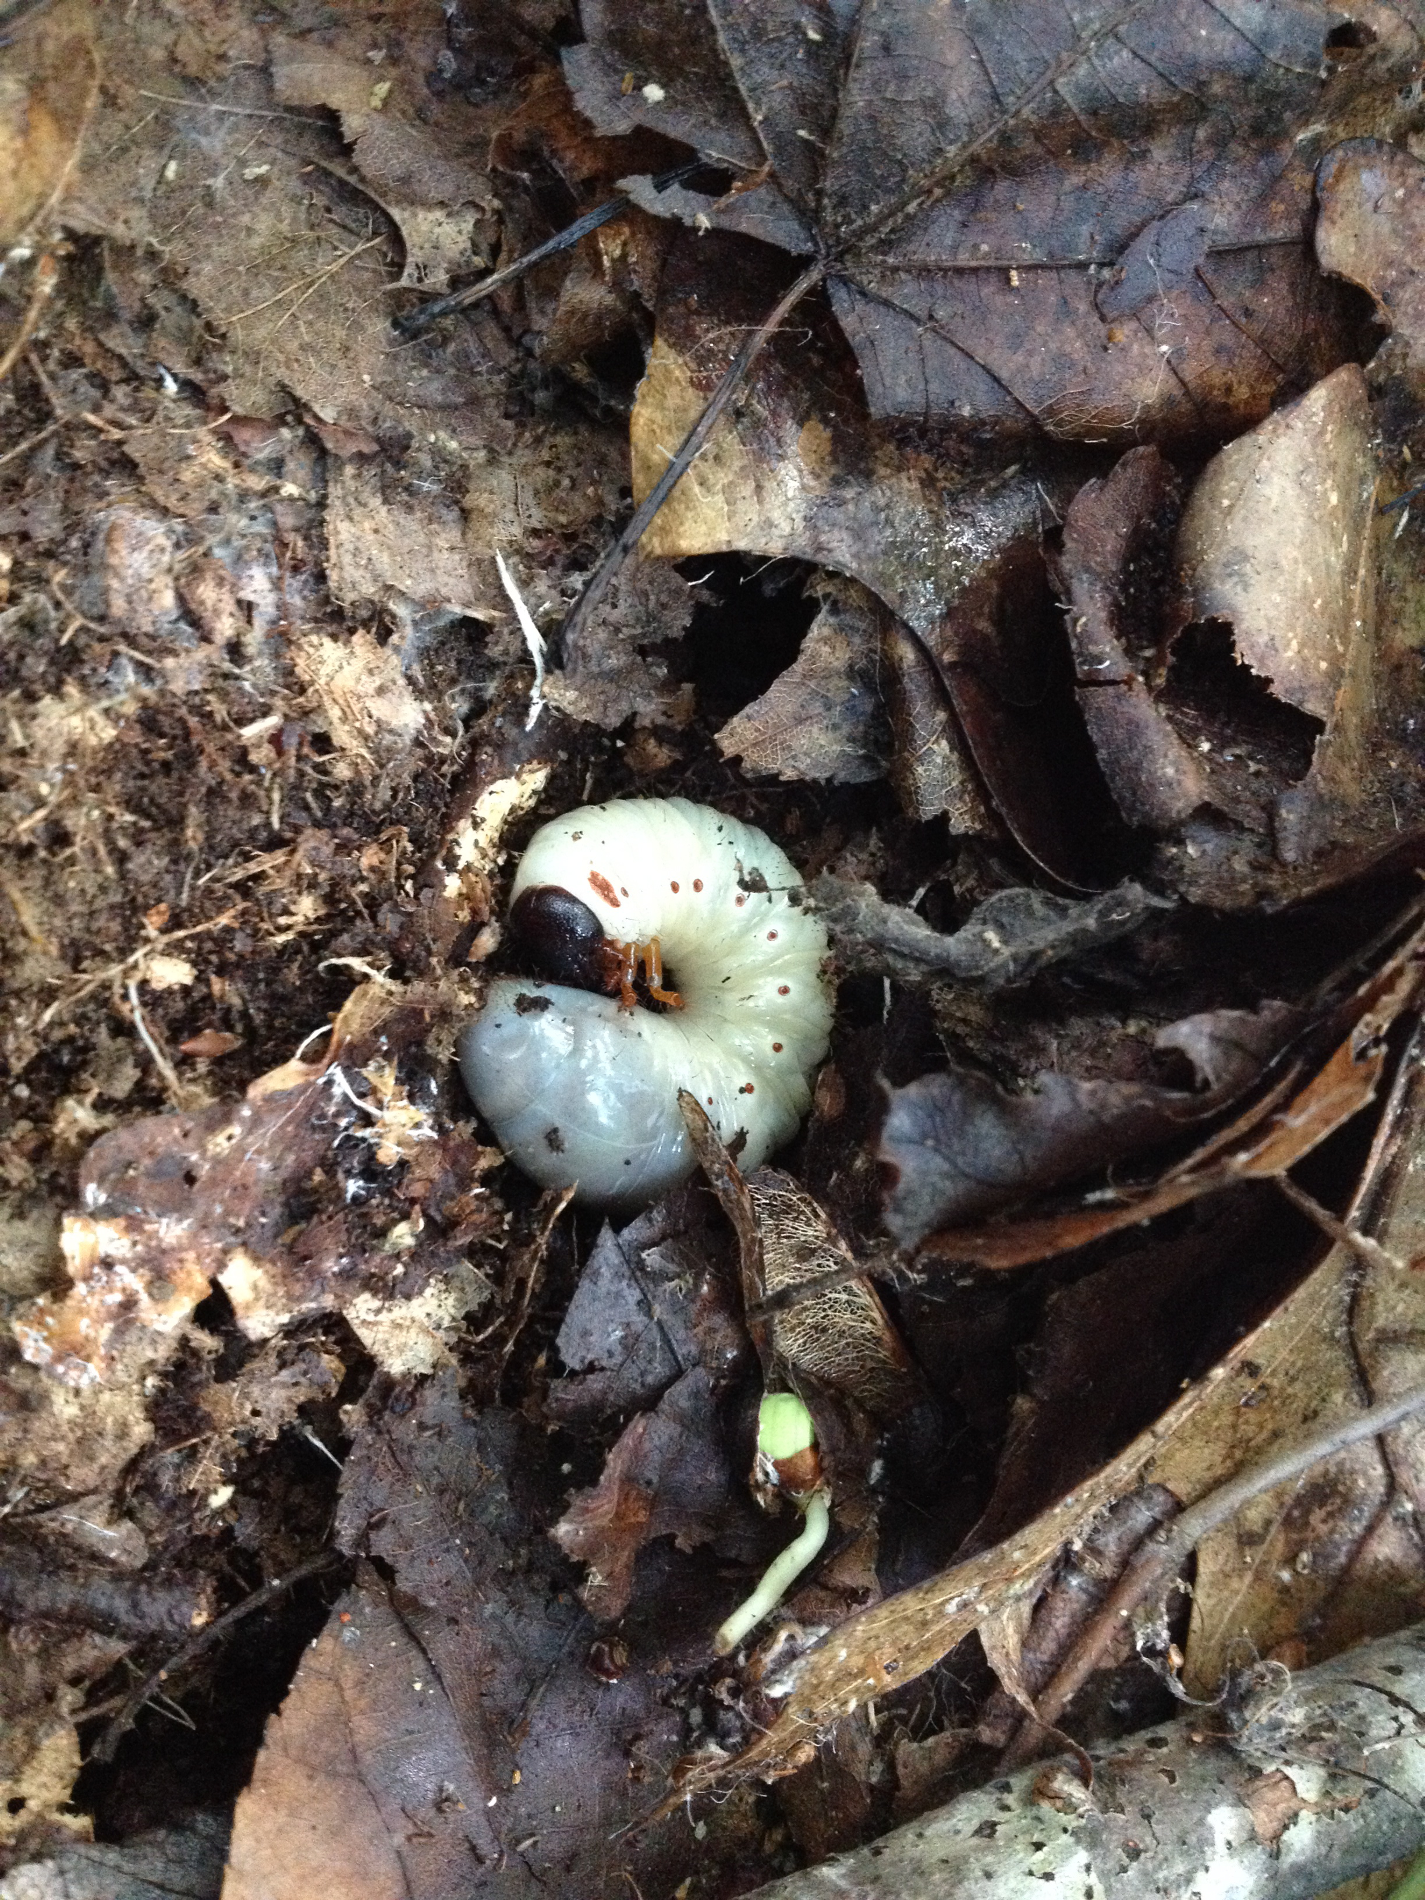
Soil organisms
Breakdown organic material
Releases mineral nutrients
Stabilizes soil structure
Forms humus
Inorganic transformations
Transforms N, P, S into plant available forms
Nitrogen fixation
Fix N₂ from atmosphere

Slide 19
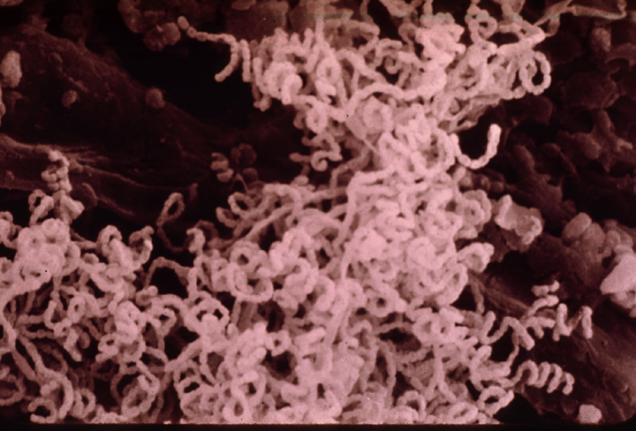
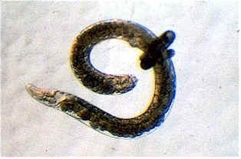
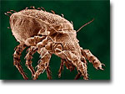
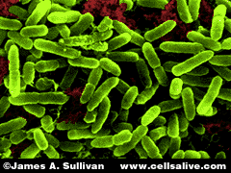
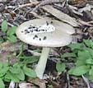
Microbial community characteristics determine litter decomposition
Community composition
Who’s there
Enzyme activity – speed breakdown
Most processes are mediated by enzymes secreted

Slide 20
Extra-cellular enzymes in soils involved in C and N transformations:
Enzymes involved in C transformations
-glucosidase
(1st step in cellulose degradation)
-cellulase
(cellulose to glucose)
-phenol oxidase
(phenolic breakdown)
Enzymes involved in N transformations
-protease
(proteins to polypeptides to amino acids)
-urease
(urea to ammonia)
Microorganisms & plants (especially fungi & yeast)
Primarily fungi, some actinomycetes
Primarily fungi
Nearly all microorganisms
Microorganisms & plants

Slide 21
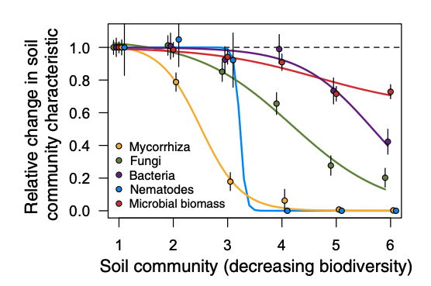
Wagg et al. 2014

Slide 22
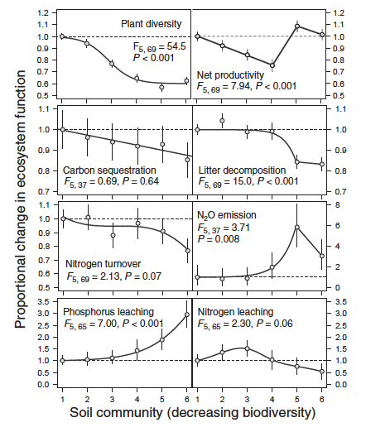
Wagg et al. 2014

Slide 23
Major controls of decomposition
Litter Quality
Climate
Decomposition
Soil Fauna

Slide 24
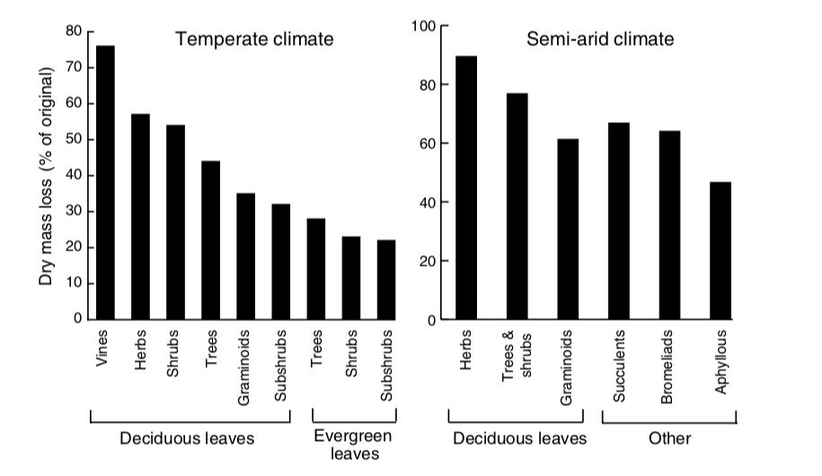
Litter quality varies with plant type

Slide 25
Litter quality varies with plant type
Why don’t all decompose fast?

Slide 26
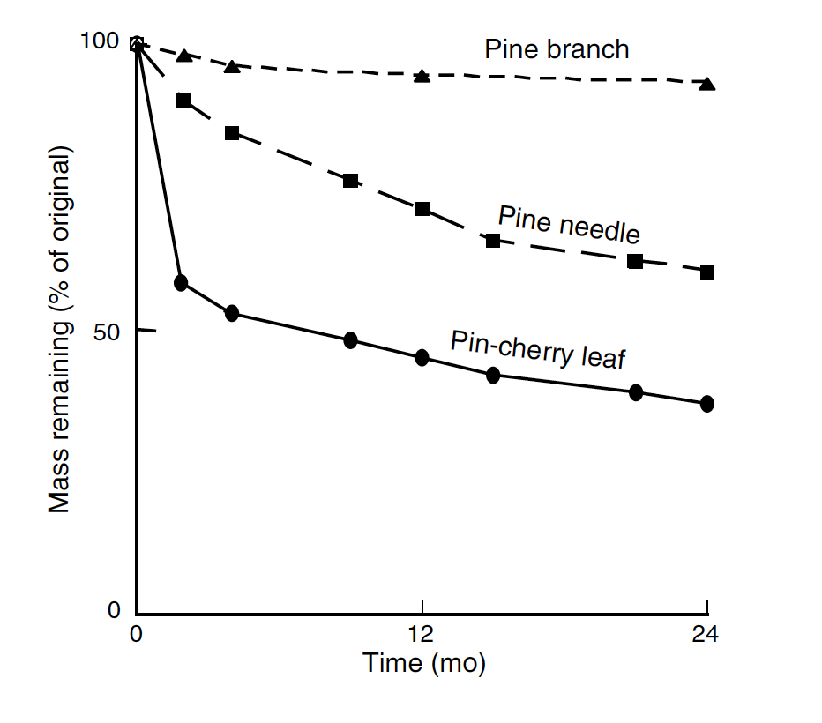
Leaves decompose faster than branches

Slide 27
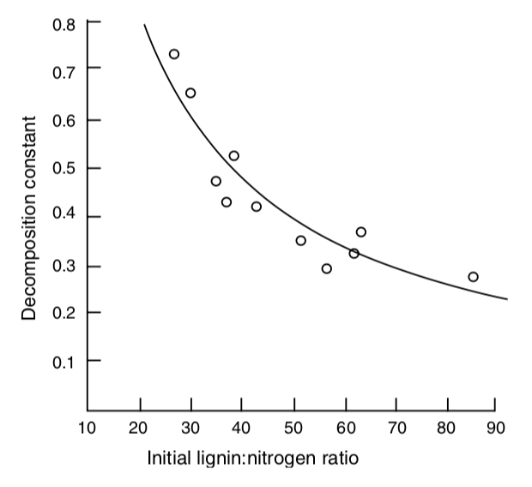
Higher nutrient litter decomposes faster

Slide 28
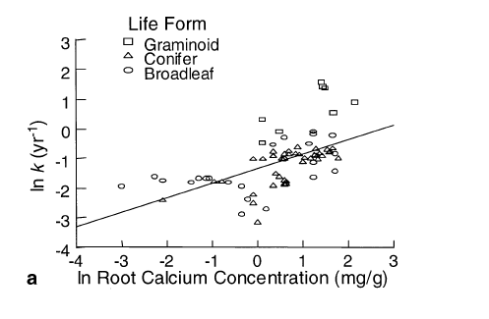
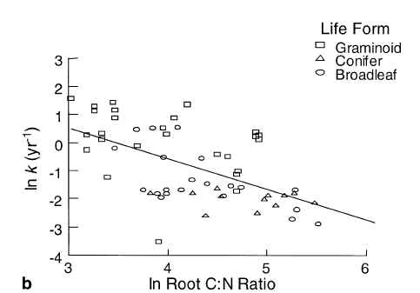
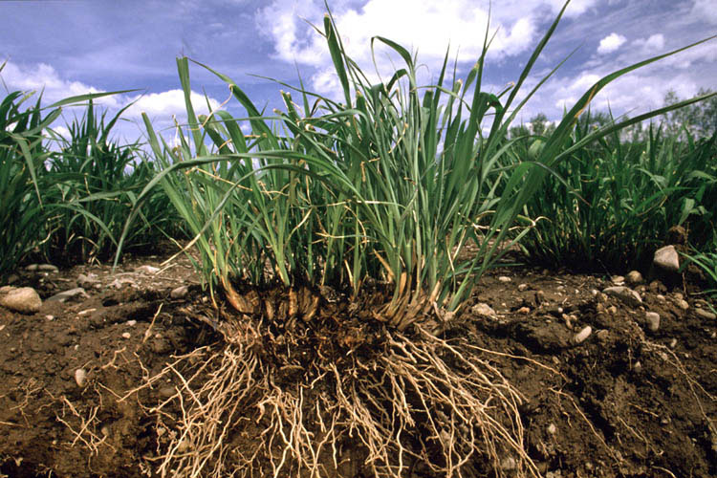
Higher nutrient litter decomposes faster
Silver & Miya 2001

Slide 29
Major controls of decomposition
Litter Quality
Climate
Decomposition
Soil Fauna

Slide 30
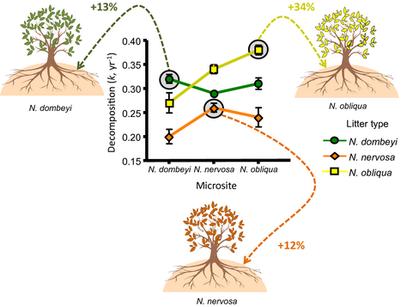
Home Field Advantage
Do microbes decompose substrates that they’ve
“seen” before better than naïve substrates?
Austin et al. 2014
Notes:
Nothofagus

Slide 31
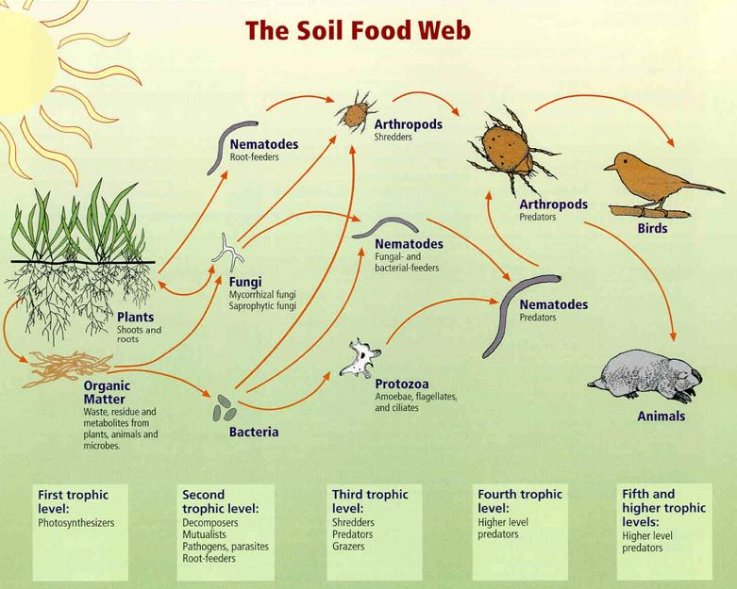
Why is the ground brown?

